Slide 1



Noida Institute of Engineering and Technology, Greater Noida
String Matching, Approximation Algorithms and Theory of NP Completeness
Unit: 5
Design & Analysis of Algorithms
Ms. Anamika Chaudhary
Assistant Professor CSE(DS) Department
B.Tech 5th Sem

Slide 2

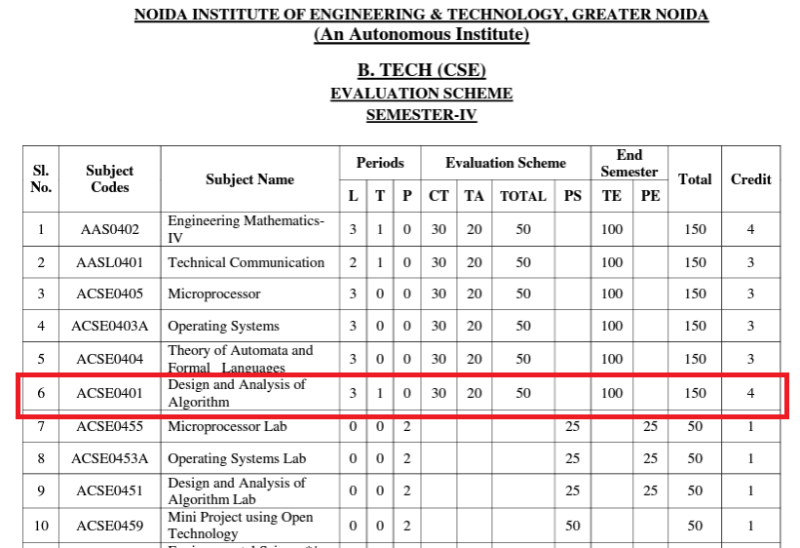
Evaluation Scheme

Slide 3
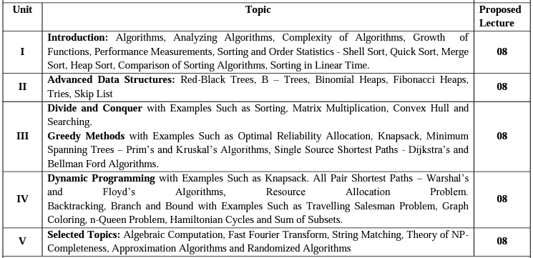
Syllabus

Slide 4
Branch wise Application
In Data mining
Image Processing
Digital Signature.
DNA Matching.

Slide 5
Course Objective
Upon completion of this course, students will be able to do the following:
Analyze the asymptotic performance of algorithms.
Write rigorous correctness proofs for algorithms.
Demonstrate a familiarity with major algorithms and data structures.
Apply important algorithmic design paradigms and methods of analysis.
Synthesize efficient algorithms in common engineering design situations.

Slide 6
Course Outcome
At the end of the semester, the student will be able:
 | Description | Bloom’s Taxonomy
CO1 | To have knowledge of basic principles of algorithm design and Analysis, asymptotic notations and growth of functions for time and space complexity analysis and applying the same in different sorting algorithms | Knowledge, analysis And design
CO2 | To apply different problem-solving approaches for advanced data structures | Knowledge, analysis And apply
CO3 | To apply divide and conquer method for solving merge sort, quick sort, matrix multiplication and Greedy Algorithm for solving different Graph Problem. | Knowledge, analysis and Apply
CO4 | To analyze and apply different optimization techniques like dynamic programming, backtracking and Branch & Bound to solve the complex problems | Knowledge, Analysis And Apply
CO5 | To understand the advanced concepts like NP Completeness and Fast Fourier Transform, to analyze and apply String Matching, Approximation and Randomized Algorithms to solve the complex problems | Knowledge, Analysis and Apply

Slide 7
Program Outcome
At the end of the semester, the student will be able:
POs | Engineering Graduates will be able to
PO1 | Engineering Knowledge
PO2 | Problem Analysis
PO3 | Design & Development of solutions
PO4 | Conduct Investigation of complex problems
PO5 | Modern Tool Usage
PO6 | The Engineer and Society
PO7 | Environment and sustainability
PO8 | Ethics
PO9 | Individual & Team work
PO10 | Communication
PO11 | Project management and Finance
PO12 | Life Long Learning

Slide 8
CO-PO and PSO Mapping
Design and Analysis of Algorithm (kCS-502)
CO.K | PO1 | PO2 | PO3 | PO4 | PO5 | PO6 | PO7 | PO8 | PO9 | PO10 | PO11 | PO12
ACSE0401.1 | 3 | 3 | 3 | 3 | 2 | - | - | - | 2 | 2 | - | 3
ACSE0401.2 | 3 | 3 | 3 | 3 | 2 | 2 | - | 1 | 1 | 1 | - | 3
ACSE0401.3 | 3 | 3 | 2 | 3 | 3 | 2 | - | 2 | 1 | 1 | 2 | 3
ACSE0401.4 | 3 | 3 | 3 | 3 | 2 | 2 | - | 2 | 2 | 1 | 3 | 3
ACSE0401.5 | 2 | 2 | 2 | 2 | 2 | 2 | - | 2 | 1 | 1 | 1 | 2
Average | 2.8 | 2.8 | 2.6 | 2.8 | 2.2 | 1.6 | - | 1.8 | 1.4 | 1.2 | 1.2 | 2.8

Slide 9
Program Educational Objectives(PEOs)
PEO1: To have an excellent scientific and engineering breadth so as to
comprehend, analyze, design and provide sustainable solutions for
real-life problems using state-of-the-art technologies.
PEO2:To have a successful career in industries, to pursue higher studies or
to support enterpreneurial endeavors and to face global challenges.
PEO3:To have an effective communication skills, professional attitude,
ethical values and a desire to learn specific knowledge in emerging
trends, technologies for research, innovation and product
development and contribution to society.
PEO4: To have life-long learning for up-skilling and re-skilling for
successful professional career as engineer, scientist, enterpreneur
and bureaucrat for betterment of society

Slide 10
Result Analysis
Subject Result: 96.63 %
Department Result: 96.63 %
Faculty-Wise Result:
Mr. Harsh Vardhan Mishra (B): 93.94%
Mr. Harsh Vardhan Mishra(C): 97.01%
Mr. Twinkle Tyagi(A): 96.978%
Mr. Twinkle Tyagi(D): 98.53%

Slide 11
End Semester Question Paper Template
B TECH
(SEM-V) THEORY EXAMINATION 20__-20__
COMPILER DESIGN
Time: 3 Hours Total Marks: 100
Note: 1. Attempt all Sections. If require any missing data; then choose suitably.
SECTION A
Attempt all questions in brief. 2 x 10 = 20
Q.No. | Question | Marks | CO
1 |  | 2
2 |  | 2
. |  | .
10 |  | 2

Slide 12
End Semester Question Paper Templates
SECTION B
2. Attempt any three of the following: 3 x 10 = 30
SECTION C
3. Attempt any one part of the following: 1 x 10 = 10
Q.No. | Question | Marks | CO
1 |  | 10
2 |  | 10
. |  | .
5 |  | 10
Q.No. | Question | Marks | CO
1 |  | 10
2 |  | 10

Slide 13
End Semester Question Paper Templates
4. Attempt any one part of the following: 1 x 10 = 10
5. Attempt any one part of the following: 1 x 10 = 10
6. Attempt any one part of the following: 1 x 10 = 10
Q.No. | Question | Marks | CO
1 |  | 10
2 |  | 10
Q.No. | Question | Marks | CO
1 |  | 10
2 |  | 10
Q.No. | Question | Marks | CO
1 |  | 10
2 |  | 10

Slide 14
Prerequisite and Recap
Prerequisite
Basic concept of c programming language.
Concept of stack, queue and link list.
Recap
Flow Chart
Algorithm

Slide 15
Unit Content
Algebraic Computation
Fast Fourier Transform
String Matching
Theory of NP-completeness
Approximation algorithms
Randomized algorithms.
.

Slide 16
Unit Objective
This objective this unit is to make students understand about
Different classes of problems , P Class, NP class, NPC.
Different string matching algorithms.
The Approximation algorithm and Randomized algorithm
.

Slide 17
Topic Objective
This objective this topic is to make students understand about
Computational Mathematics.
Algebraic Structures
Representation
FFT & DFT

Slide 18
Algebraic Computation(CO5)
In computational mathematics, computer algebra, also called symbolic computation or algebraic computation, is a scientific area that refers to the study and development of algorithms and software for manipulating mathematical expressions and other mathematical objects.
Although , computer algebra should be a subfield of scientific computing is generally based on numerical computation with inexact floating point number, while representation computation emphasize exact computation with terminology contain variables that have no given value and are manipulated as symbols, hence the representation computation

Slide 19
Algebraic Computation(CO5)
Algebraic Structures
Basic requirements
precise representation of algebraic structures
precise arithmetic with algebraic structures
other analytical operations with these structures (e.g., differentiation , integration )

Slide 20
Algebraic Computation(CO5)
To work on a computer with algebraic structures, we need to represent them by some sort of data structures
Representation is very important because often the effectiveness of an algorithm will depend on the representation that is used.
Can be represented by
Representation of integers
Representation of polynomials
Representation of expressions

Slide 21
Algebraic Computation(CO5)
,
Fast Fourier transformation
The discovery of the Fast Fourier transformation (FFT) is attributed to Cooley and Tukey, who published an algorithm in 1965.
A fast Fourier transform (FFT) is an algorithm that computes the Discrete Fourier Transform (DFT) of a sequence, or its inverse (IDFT).
Fourier analysis converts a signal from its original domain (often time or space) to a representation in the frequency domain and vice versa.
The DFT is obtained by decomposing a sequence of values into components of different frequencies.

Slide 22
Algebraic Computation(CO5)
,
Fast Fourier transformation
This operation is useful in many fields, but computing it directly from the definition is often too slow to be practical.
An FFT rapidly computes such transformations by factorizing the DFT matrix into a product of sparse (mostly zero) factors.
It manages to reduce the complexity of computing the DFT from O(N²), which arises if one simply applies the definition of DFT , to O(NlogN), where N is the size of data.
The difference in speed can be enormous, especially for long data sets where N may be in the thousands or millions.

Slide 23
Algebraic Computation(CO5)
Discrete Fourier transformation
The discrete fourier transform (DFT) of the polynomial A(x) (or equivalently the vector of coefficients (a₀,a₁,…,a _{n−1}) is defined as the values of the polynomial at the points x=w_{n,k} i.e. it is the vector:
DFT(a₀,a₁,…,a_{n−1}) =(y₀,y₁,…,y_{n−1})
=(A(w_{n},₀),A(w_{n},₁),…,A(w_{n},_{n−1})
=(A(w⁰_{n}),A(w¹_{n}),…,A(w^{n−1}_{n}))
Thus, if a direct DFT computes the values of the polynomial at the points at the n-th roots, the inverse DFT can restore the coefficients of the polynomial using those values.

Slide 24
Algebraic Computation(CO5)
The fast Fourier transform is a method that allows computing the DFT in O(nlogn) time.
The basic idea of the FFT is to apply divide and conquer.
We divide the coefficient vector of the polynomial into two vectors, recursively compute the DFT for each of them, and combine the results to compute the DFT of the complete polynomial.

Slide 25
Algebraic Computation(CO5)
Inverse DFT
The inverse DFT of values of the polynomial (y₀,y₁,…,y_{n-1}) are the coefficients of the polynomial (a₀,a₁,…,a _{n−1}) .
InverseDFT(y₀,y₁,…,y_{n−1}) = (a₀,a₁,…,a_{n−1})
Thus, if a direct DFT computes the values of the polynomial at the points at the n-th roots, the inverse DFT can restore the coefficients of the polynomial using those values.
The computation of the inverse DFT is almost the same as the calculation of the direct DFT, and it also can be performed in O(nlogn)⁡.

Slide 26
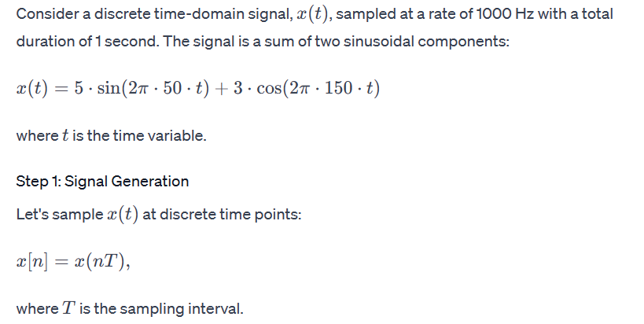
Example of Fast Fourier Transform (FFT):
Algebraic Computation(CO5)

Slide 27
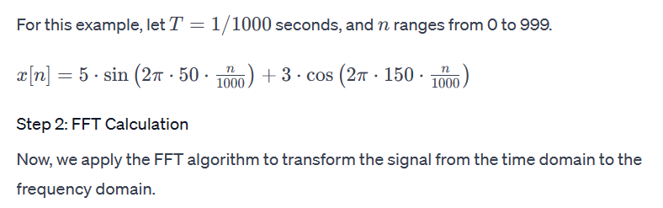
Example of Fast Fourier Transform (FFT):
Algebraic Computation(CO5)

Slide 28
Example of Fast Fourier Transform (FFT):
Algebraic Computation(CO5)
import numpy as np
import matplotlib.pyplot as plt
n = np.arange(0, 1000)
T = 1/1000
x = 5 * np.sin(2 * np.pi * 50 * n * T) + 3 * np.cos(2 * np.pi * 150 * n * T)
# Fast Fourier Transform
fft_result = np.fft.fft(x)
fft_freq = np.fft.fftfreq(len(n), T)
# Plot the original signal
plt.subplot(2, 1, 1)
plt.plot(n, x)
plt.title('Original Signal')
plt.xlabel('Time (ms)')
plt.ylabel('Amplitude')
# Plot the FFT result
plt.subplot(2, 1, 2)
plt.plot(fft_freq, np.abs(fft_result))
plt.title('FFT Result')
plt.xlabel('Frequency (Hz)')
plt.ylabel('Amplitude Spectrum')
plt.tight_layout()
plt.show()

Slide 29
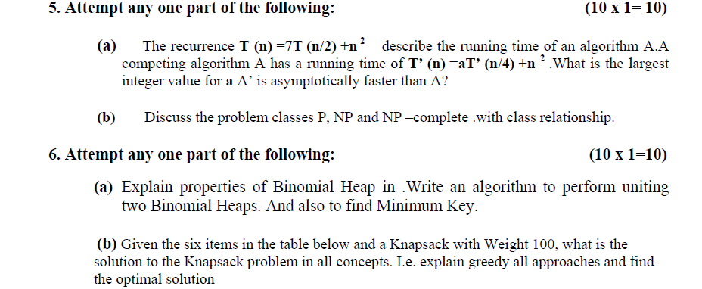
String Matching(CO5)
Objective
This objective this topic is to make students understand about
Concepts of String Matching
Naïve String Matching
Rabin Karp Algorithm
Knuth Morris Pratt
String Matching with automata
Boyer Moore Algorithm

Slide 30
Prerequisite and Recap
Prerequisite
Algorithms
Finite automata
Recap
Algebraic Computation

Slide 31
String Matching (CO5)
String Matching Algorithm is also called "String Searching Algorithm” are an important class of string algorithm that try to find a place where one or several strings(also called patterns) are found within a larger string or text.
Given a text array, T [1.....n], of n character and a pattern array, P [1......m], of m characters. The problems are to find an integer s, called valid shift where 0 ≤ s < n-m and T [s+1......s+m] = P [1......m].
In other words, to find even if P in T, i.e., where P is a substring of T.
The item of P and T are character drawn from some finite alphabet such as {0, 1} or {A, B .....Z, a, b..... z}.

Slide 32
String Matching (CO5)
Given a string T [1......n], the substrings are represented as T [i......j] for some 0≤i ≤ j≤n-1, the string formed by the characters in T from index i to index j, inclusive. This process that a string is a substring of itself (take i = 0 and j =m).
The proper substring of string T [1......n] is T [1......j] for some 0<i ≤ j≤n-1. That is, we must have either i>0 or j < m-1.

Slide 33
String Matching(CO5)
Using these descriptions, we can say given any string T [1......n], the substrings are
T [i.....j] = T [i] T [i +1] T [i+2]......T [j] for some 0≤i ≤ j≤n-1.
And proper substrings are
T [i.....j] = T [i] T [i +1] T [i+2]......T [j] for some 0≤i ≤ j≤n-1.
Note: If i>j, then T [i.....j] is equal to the empty string or null, which has length zero.

Slide 34
String Matching(CO5)
Algorithms used for String Matching:
There are different types of method is used to finding the string
The Naive String Matching Algorithm
The Rabin-Karp-Algorithm
Finite Automata
The Knuth-Morris-Pratt Algorithm
The Boyer-Moore Algorithm

Slide 35
String Matching(CO5)
Naïve String Matching Algorithm
The naïve approach tests all the possible placement of Pattern P [1.......m] relative to text T [1......n]. We try shift s = 0, 1.......n-m, successively and for each shift s. Compare T [s+1.......s+m] to P [1......m].
The naïve algorithm finds all valid shifts using a loop that checks the condition P [1.......m] = T [s+1.......s+m] for each of the n - m +1 possible value of s.

Slide 36
String Matching(CO5)
NAIVE-STRING-MATCHER (T, P)
1. n ← length [T]
2. m ← length [P]
3. for s ← 0 to n -m
4. do if P [1.....m] = T [s + 1....s + m]
5. then print "Pattern occurs with shift" s
Analysis: This for loop from 3 to 5 executes for n-m + 1(we need at least m characters at the end) times and in iteration we are doing m comparisons. So the total complexity is O (n-m+1)

Slide 37
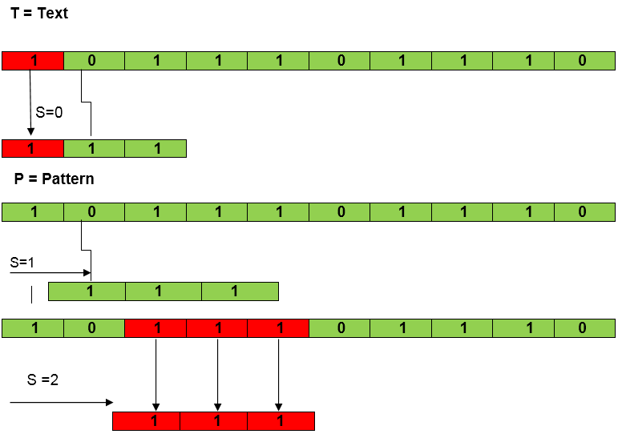
String Matching(CO5)
Example:
Suppose T = 1011101110 , P = 111 . Find all the Valid Shift
Solution:

Slide 38
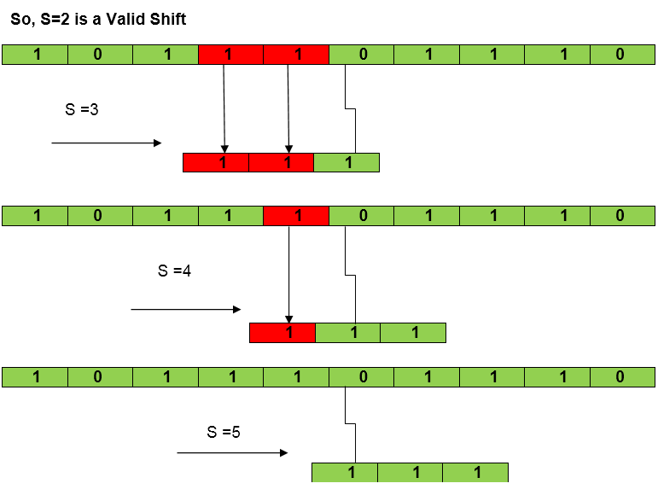
String Matching(CO5)

Slide 39
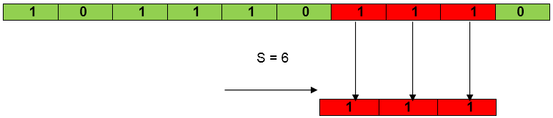
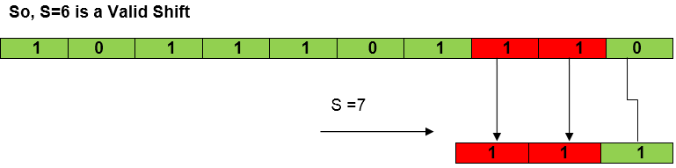
String Matching Algorithm (CO5)

Slide 40
String Matching(CO5)
Rabin- Karp- Algorithm
The Rabin-Karp string matching algorithm calculates a hash value for the pattern, as well as for each M-character subsequences of text to be compared.
If the hash values are unequal, the algorithm will determine the hash value for next M-character sequence.
If the hash values are equal, the algorithm will analyze the pattern and the M-character sequence.
In this way, there is only one comparison per text subsequence, and character matching is only required when the hash values match.

Slide 41
String Matching(CO5)
Rabin Karp Matcher(T, P, d, q)
n←length[T]
m←length[P]
h←d^{m-1} mod q
p←0
t₀ ←0
For i←1 to m (preprocessing)
do p←(dp +P[i])modq
t₀ ←(d t₀ +T[i])modq
For s←0 to n-m (matching)
do if p = t_{s}
then if P[1…..m] = T[s +1,……..s+m]
then “Pattern occurs with shift” s
If s< n-m
then t_{s+1} ←(d(t_{s} – T[s+1]h) + T[s+m+1]) mod q

Slide 42
String Matching(CO5)
Rabin- Karp- Algorithm
Complexity: The running time of RABIN-KARP-MATCHER in the worst case scenario O ((n-m+1) m but it has a good average case running time. If the expected number of strong shifts is small O (1) and prime q is chosen to be quite large, then the Rabin-Karp algorithm can be expected to run in time O (n+m) plus the time to require to process spurious hits.
Example: For string matching, working module q = 11, how many spurious hits does the Rabin-Karp matcher encounters in Text T = 31415926535.......
T = 31415926535.......
P = 26
Here T.Length =11 so Q = 11
And P mod Q = 26 mod 11 = 4
Now find the exact match of P mod Q...

Slide 43
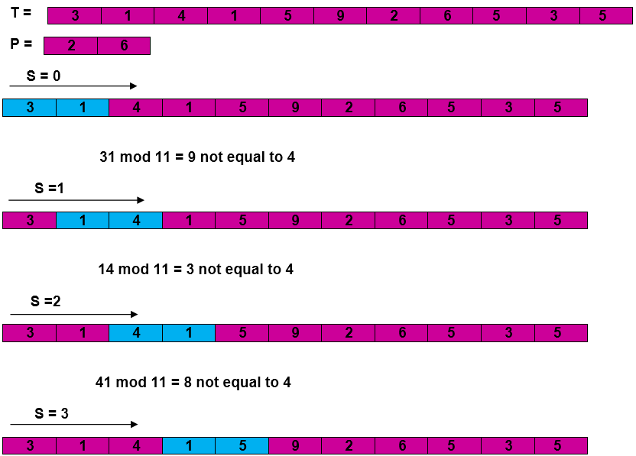
String Matching(CO5)
Rabin- Karp- Algorithm
Solution:

Slide 44
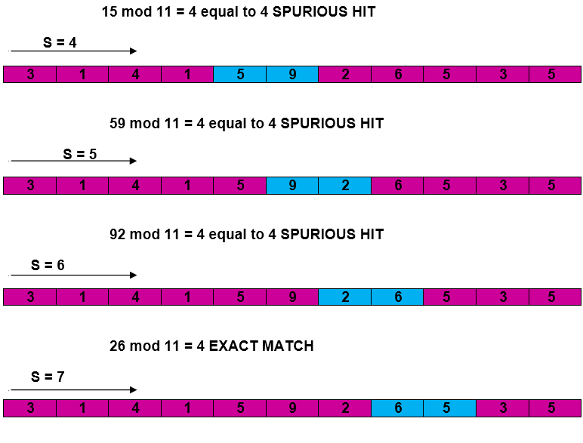
String Matching(CO5)
Rabin- Karp- Algorithm

Slide 45
String Matching(CO5)
Rabin- Karp- Algorithm

Slide 46
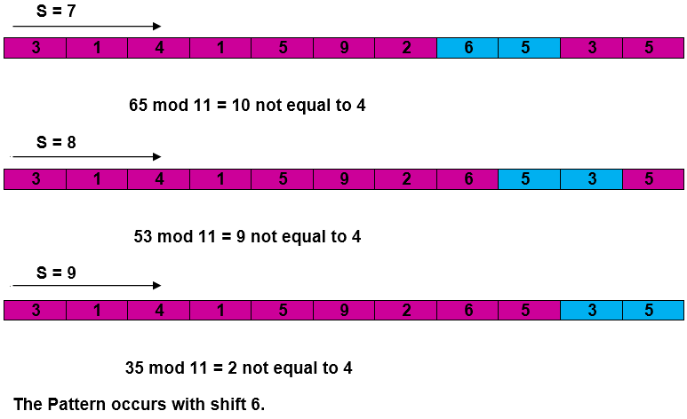
String Matching(CO5)
Rabin- Karp- Algorithm

Slide 47
String Matching(CO5)
Rabin- Karp- Algorithm
The string-matching automaton is a very useful tool which is used in string matching algorithm.
It examines every character in the text exactly once and reports all the valid shifts in O (n) time.
The goal of string matching is to find the location of specific text pattern within the larger body of text (a sentence, a paragraph, a book, etc.)

Slide 48
String Matching(CO5)
String Matching With Finite Automata
A finite automaton M is a 5-tuple (Q, q₀,A,∑_{δ}), where
Q is a finite set of states,
q₀ ∈ Q is the start state,
A ⊆ Q is a notable set of accepting states,
∑ is a finite input alphabet,
δ is a function from Q x ∑ into Q called the transition function of M.
The finite automaton starts in state q₀ and reads the characters of its input string one at a time.
If the automaton is in state q and reads input character a, it moves from state q to state δ (q, a).
Whenever its current state q is a member of A, the machine M has accepted the string read so far. An input that is not allowed is rejected.

Slide 49
String Matching(CO5)
Example: String Matching with Finite Automata
Consider the text:
Text: A B A B D A B A C D A B A B C A B A B
And the pattern:
Pattern: A B A B C A B A B

Slide 50
String Matching(CO5)
Example: String Matching with Finite Automata
Step 1: Build Transition Table
Construct the transition table for the pattern "ABABCABAB". The transition table helps determine the next state to move based on the characters encountered in the text.
State | A | B | C | D
------|---|---|---|---
0 | 1 | 0 | 0 | 0
1 | 1 | 2 | 0 | 0
2 | 1 | 0 | 3 | 0
3 | 1 | 4 | 0 | 0
4 | 1 | 0 | 0 | 5
5 | 1 | 2 | 0 | 0
6 | 1 | 0 | 3 | 0
7 | 1 | 8 | 0 | 0
8 | 1 | 0 | 0 | 9
9 | 1 | 2 | 0 | 0
10 | 1 | 0 | 3 | 0

Slide 51
String Matching(CO5)
Example: String Matching with Finite Automata
Step 2: Matching Process
Now, let's use the Finite Automata to find matches in the text:
Starting at state 0, for the first 'A', transition to state 1.
For 'B', transition to state 2.
For 'A', transition to state 3.
For 'B', transition to state 4.
For 'C', transition to state 5.
For 'A', transition to state 6.
For 'B', transition to state 7.
For 'A', transition to state 8.
For 'B', transition to state 9.
For the second 'A', transition to state 10.
At state 10, the pattern is completely matched.

Slide 52
String Matching(CO5)
Knuth-Morris and Pratt Algorithm
Knuth-Morris and Pratt introduce a linear time algorithm for the string matching problem.
A matching time of O (n) is achieved by avoiding comparison with an element of 'S' that have previously been involved in comparison with some element of the pattern 'p' to be matched. i.e., backtracking on the string 'S' never occurs.

Slide 53
String Matching(CO5)
Components of KMP Algorithm:
The Prefix Function (Π): The Prefix Function, Π for a pattern encapsulates knowledge about how the pattern matches against the shift of itself. This information can be used to avoid a useless shift of the pattern 'p.' In other words, this enables avoiding backtracking of the string 'S.’
The KMP Matcher: With string 'S,' pattern 'p' and prefix function 'Π' as inputs, find the occurrence of 'p' in 'S' and returns the number of shifts of 'p' after which occurrences are found.

Slide 54
String Matching(CO5)
The Prefix Function (Π)
Following pseudo code compute the prefix function, Π:
Compute-Prefix-function(P)
n←length[P]
Π[1]←0
K←0
for q←2 to m
do while k > 0 and P[k+1] ≠ P[q]
do k← Π[k]
if P[k+1] = P[q]
then k← k+1
Π[q]←k
Return Π
In the above pseudo code for calculating the prefix function, the for loop from step 4 to step 10 runs 'm' times. Step1 to Step3 take constant time. Hence the running time of computing prefix function is O (m).

Slide 55
String Matching(CO5)
Knuth-Morris and Pratt Algorithm
Example: Compute Π for the pattern 'p' below:
Solution:
Initially: m = length [p] = 7 Π [1] = 0 k = 0

Slide 56
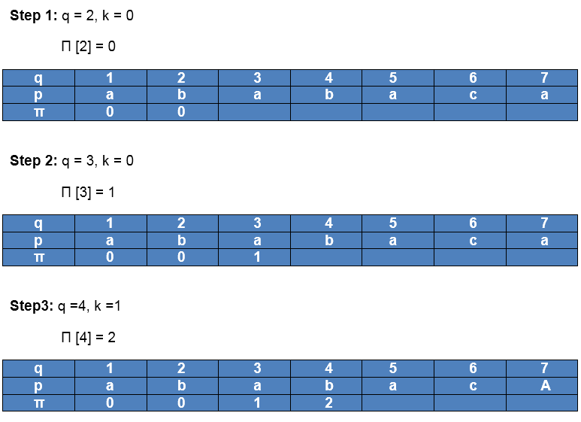
String Matching(CO5)
Knuth- Morris and Pratt(KMP) algorithm

Slide 57
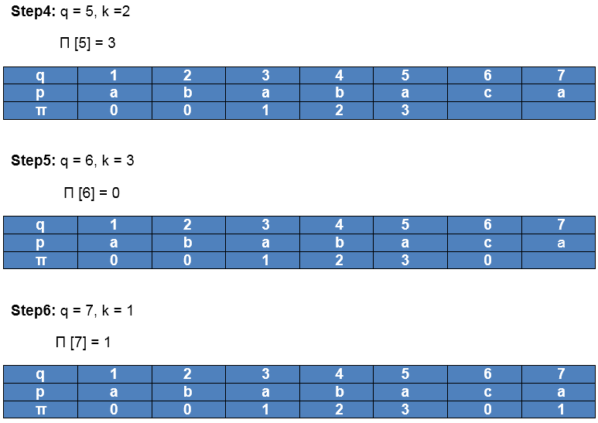
String Matching(CO5)
Knuth-Morris and Pratt Algorithm

Slide 58
String Matching(CO5)
Boyer and Moore Algorithm
Robert Boyer and J Strother Moore established it in 1977. The B-M String search algorithm is a particularly efficient algorithm and has served as a standard benchmark for string search algorithm ever since.
The B-M algorithm takes a 'backward' approach: the pattern string (P) is aligned with the start of the text string (T), and then compares the characters of a pattern from right to left, beginning with rightmost character.
If a character is compared that is not within the pattern, no match can be found by analyzing any further aspects at this position so the pattern can be changed entirely past the mismatching character.

Slide 59
String Matching(CO5)
Boyer and Moore Algorithm
For deciding the possible shifts, B-M algorithm uses two preprocessing strategies simultaneously. Whenever a mismatch occurs, the algorithm calculates a variation using both approaches and selects the more significant shift thus, if make use of the most effective strategy for each case.
The two strategies are called heuristics of B - M as they are used to reduce the search. They are
Bad Character Heuristics
Good Suffix Heuristics

Slide 60
String Matching(CO5)
Boyer and Moore Algorithm
Bad Character Heuristics
This Heuristics has two implications:
Suppose there is a character in a text in which does not occur in a pattern at all. When a mismatch happens at this character (called as bad character), the whole pattern can be changed, begin matching form substring next to this 'bad character.’
On the other hand, it might be that a bad character is present in the pattern, in this case, align the nature of the pattern with a bad character in the text.
Thus in any case shift may be higher than one.

Slide 61
String Matching(CO5)
Good Suffix Heuristics:
A good suffix is a suffix that has matched successfully.
After a mismatch which has a negative shift in bad character heuristics, look if a substring of pattern matched till bad character has a good suffix in it, if it is so then we have an onward jump equal to the length of suffix found.
Boyer and Moore Algorithm

Slide 62
String Matching(CO5)
Example: String Matching with Boyer-Moore Algorithm
Consider the text:
Text: A B A B D A B A C D A B A B C A B A B
And the pattern:
Pattern: A B A B C A B A B
Boyer and Moore Algorithm Example

Slide 63
String Matching(CO5)
Boyer and Moore Algorithm Example
Step 1: Preprocessing (Bad Character Heuristic)
Construct the Bad Character Heuristic table, which indicates the rightmost occurrence of each character in the pattern.
Character | A | B | C | D
----------|---|---|---|---
Index | 8 | 9 | 5 | -
Step 2: Matching Process
Now, let's use the Boyer-Moore algorithm to find matches in the text:

Slide 64
String Matching(CO5)
Boyer and Moore Algorithm Example
Align the pattern starting at the end with the corresponding part of the text.
Text: A B A B D A B A C D A B A B C A B A B
^
Pattern: A B A B C A B A B
Compare characters from right to left.
Characters 'C' and 'B' match.
Characters 'B' and 'B' match.
Characters 'A' and 'A' match.
Characters 'B' and 'B' match.
The entire pattern is matched. Record the position.
Matches at positions: [16]
Slide the pattern using the Bad Character Heuristic.

Slide 65
String Matching(CO5)
Boyer and Moore Algorithm Example
The rightmost occurrence of 'A' in the pattern is at index 8, so shift the pattern to align the rightmost 'A' with the mismatched 'D' in the text.
Text: A B A B D A B A C D A B A B C A B A B
^
Pattern: A B A B C A B A B
Continue the matching process.
Characters 'B' and 'B' match.
Characters 'A' and 'A' match.
Characters 'B' and 'B' match.
The entire pattern is matched again. Record the position.
Matches at positions: [16, 18]
Continue sliding the pattern and matching until the end of the text.

Slide 66
String Matching(CO5)
Boyer and Moore Algorithm Example
Conclusion:
The Boyer-Moore algorithm efficiently finds matches in the given text. In this example, the pattern "ABABCABAB" is found at positions 16 and 18 in the text. The algorithm skips portions of the text based on the Bad Character Heuristic, making it a powerful and efficient string-matching algorithm.

Slide 67
NPCompleteness(CO5)
Objective
This objective this topic is to make students understand about
Different Class of problems
P Class
NP Class
NPC
Hard Problems
Approximation and Randomized algorithm

Slide 68
Prerequisite and Recap
Prerequisite
Different Problems like graph colouring
Travelling Salesman Problem
Recap
String Matching Algorithm
Algorithms for solving real world problems

Slide 69
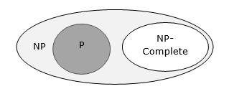
NPCompleteness(CO5)
A problem is in the class NPC if it is in NP and is as hard as any problem in NP. A problem is NP-hard if all problems in NP are polynomial time reducible to it, even though it may not be in NP itself.
If a polynomial time algorithm exists for any of these problems, all problems in NP would be polynomial time solvable. These problems are called NP-complete. The phenomenon of NP-completeness is important for both theoretical and practical reasons.

Slide 70
NPCompleteness(CO5)
A language B is NP-complete if it satisfies two conditions
B is in NP
Every A in NP is polynomial time reducible to B.
If a language satisfies the second property, but not necessarily the first one, the language B is known as NP-Hard. Informally, a search problem B is NP-Hard if there exists some NP-Complete problem A that Turing reduces to B.
The problem in NP-Hard cannot be solved in polynomial time, until P = NP. If a problem is proved to be NPC, there is no need to waste time on trying to find an efficient algorithm for it. Instead, we can focus on design approximation algorithm.

Slide 71
NPCompleteness(CO5)
NP-Complete Problems
Following are some NP-Complete problems, for which no polynomial time algorithm is known.
Determining whether a graph has a Hamiltonian cycle
Determining whether a Boolean formula is satisfiable, etc.
NP-Hard Problems
The following problems are NP-Hard
The circuit-satisfiability problem
Set Cover
Vertex Cover
Travelling Salesman Problem

Slide 72
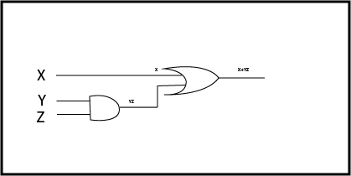
NPCompleteness(CO5)
Circuit Satisfiability
According to given decision-based NP problem, we can design the CIRCUIT and verify a given mentioned output also within the P time. The CIRCUIT is provided below:-
Although we can design a circuit and verified the mentioned output within Polynomial time but remember we can never predict the number of gates which produces the high output against the set of inputs/high inputs within a polynomial time. So we verified the production and conversion had been done within polynomial time. So it is NPC.

Slide 73
NPCompleteness(CO5)
Set Cover Problem
Given a universe U of n elements, a collection of subsets of U say S = {S₁, S₂…,S_{m}} where every subset S_{i} has an associated cost.
Find a minimum cost subcollection of S that covers all elements of U.
There is no polynomial time solution available for this problem as the problem is a known NP-Hard problem

Slide 74
NPCompleteness(CO5)
Example:
U = {1,2,3,4,5}, S = {S₁,S₂,S₃}
S₁ = {4,1,3}, Cost(S₁) = 5
S₂ = {2,5}, Cost(S₂) = 10
S₃ = {1,4,3,2}, Cost(S₃) = 3
Output: Minimum cost of set cover is 13 and set cover is {S2, S3}
There are two possible set covers {S₁, S₂} with cost 15 and {S₂, S₃} with cost 13

Slide 75
NPCompleteness(CO5)
Vertex Cover problem
The minimum vertex cover problem is the optimization problem of finding a smallest vertex cover in a given graph. The vertex cover problem is an NP-complete problem.
A vertex-cover of an undirected graph G = (V, E) is a subset of vertices V' ⊆ V such that if edge (u, v) is an edge of G, then either u in V or v in V' or both.
APPROX-VERTEX_COVER (G: Graph) c ← { } E' ← E[G]
1. while E' is not empty do
2. Let (u, v) be an arbitrary edge of E' c ← c U {u, v}
3. Remove from E' every edge incident on either u or v
4. return c

Slide 76
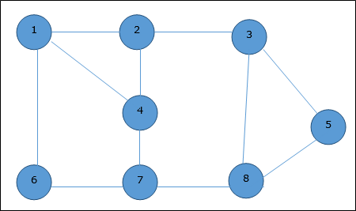
NPCompleteness(CO5)
Example:
The set of edges of the given graph is −
{(1,6),(1,2),(1,4),(2,3),(2,4),(6,7),(4,7),(7,8),(3,8),(3,5),(8,5)}

Slide 77
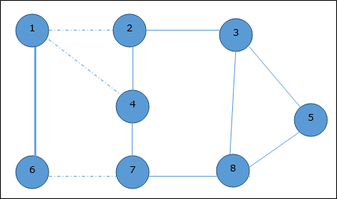

NPCompleteness(CO5)
Now, we start by selecting an arbitrary edge (1,6). We eliminate all the edges, which are either incident to vertex 1 or 6 and we add edge (1,6) to cover.
In the next step, we have chosen another edge (2,3) at random

Slide 78
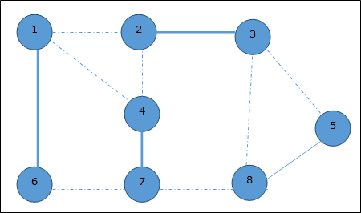

NPCompleteness(CO5)
Now we select another edge (4,7).
We select another edge (8,5).
Hence, the vertex cover of this graph is {1,2,4,5}.
Analysis
It is easy to see that the running time of this algorithm is O(V + E), using adjacency list to represent E'.

Slide 79
NPCompleteness(CO5)
Travelling Salesman Problem
The traveling salesman problem consists of a salesman and a set of cities.
The salesman has to visit each one of the cities starting from a certain one and returning to the same city.
The challenge of the problem is that the traveling salesman wants to minimize the total length of the trip

Slide 80
NPCompleteness(CO5)
Proof
1. To prove TSP is NP-Complete, first we have to prove that TSP belongs to NP.
In TSP, we find a tour and check that the tour contains each vertex once.
Then the total cost of the edges of the tour is calculated.
Finally, we check if the cost is minimum.
This can be completed in polynomial time.
Thus TSP belongs to NP.

Slide 81
NPCompleteness(CO5)
2. Secondly, we have to prove that TSP is NP-hard.
To prove this, one way is to show that Hamiltonian cycle ≤_{p} TSP (as we know that the Hamiltonian cycle problem is NPcomplete).
Assume G = (V, E) to be an instance of Hamiltonian cycle.
Hence, an instance of TSP is constructed. We create the complete graph G' = (V, E'), where
E′={(i,j):i,j ∈ V and i≠j
E′={(i,j):i,j ∈V and i≠j
Thus, the cost function is defined as follows −
t(i,j)= 0 if (i,j) ∈ E
=1 otherwise

Slide 82
NPCompleteness(CO5)
Now, suppose that a Hamiltonian cycle h exists in G. It is clear that the cost of each edge in h is 0 in G' as each edge belongs to E. Therefore, h has a cost of 0 in G'. Thus, if graph G has a Hamiltonian cycle, then graph G' has a tour of 0 cost.
Conversely, we assume that G' has a tour h' of cost at most 0. The cost of edges in E' are 0 and 1 by definition. Hence, each edge must have a cost of 0 as the cost of h' is 0. We therefore conclude that h' contains only edges in E.
We have thus proven that G has a Hamiltonian cycle, if and only if G' has a tour of cost at most 0. TSP is NP-complete.

Slide 83
NPCompleteness(CO5)
An Approximate Algorithm is a way of approach NP-COMPLETENESS for the optimization problem.
This technique does not guarantee the best solution.
The goal of an approximation algorithm is to come as close as possible to the optimum value in a reasonable amount of time which is at the most polynomial time
A simple example of an approximation algorithm is one for the Minimum Vertex Cover problem, where the goal is to choose the smallest set of vertices such that every edge in the input graph contains at least one chosen vertex.

Slide 84
NPCompleteness(CO5)
An algorithm that uses random numbers to decide what to do next anywhere in its logic is called Randomized Algorithm.. For example, in Randomized Quick Sort, we use random number to pick the next pivot (or we randomly shuffle the array). And in Karger's algorithm, we randomly pick an edge..
For example:
Select a random number from stream, with O(1) space.
Birthday Paradox
Linearity of Expectation
Random Number generator in arbitrary probability distribution fashion

Slide 85
Faculty Video Links, Youtube & NPTEL Video Links and Online Courses Details
Self Made Video Link:
Youtube/other Video Links
https://www.youtube.com/watch?v=e2cF8a5aAhE
https://www.youtube.com/watch?v=jFW7fwa0Zm8
https://www.youtube.com/watch?v=MEz1J9wY2iM

Slide 86
Daily Quiz
What does NP stands for in complexity classes theory?
The hardest of NP problems are ____________.
Travelling sales man problem belongs to which of the class?
A problem which is both _______ and _________ is said to be NP complete.
In terms of NTIME, NP problems are the set of decision problems which can be solved using a non deterministic machine in _______ time.
Problems that can be solved in polynomial time are known as?
The sum and composition of two polynomials are always polynomials.(True/False).
.... is the class of decision problems that can be solved by non-deterministic polynomial algorithms?

Slide 87
Weekly Assignment
1.Write Rabin-Karp algorithm. For string matching working modulo q =
11, how many spurious hits does the Rabin-Karp matcher encounter
in the text T = 3141592653589793 when looking for pattern P = 26?
[CO5]
2.Define NP, NP hard and NP complete. Give example of each. [CO5]
3. Explain Approximation and Randomized algorithms. [CO5]
4. Explain Rabin Karp algorithm. For the text 2359023141526739921 and for the pattern 31415 and working modulo q=13 how many valid match and spurious hits does the Rabin matcher encounter. [CO5]
5. Write short notes on [CO5]
Algebraic Computation
FFT

Slide 88
MCQ s
Which of the following can be used to define NP complexity class? a) Verifier b) Polynomial time c) Both (a) and (b) d) None of the mentioned
Which of the following are not in NP? a) All problems in P b) Boolean Satisfiability problems c) Integer factorization problem d) None of the mentioned

Slide 89
MCQ s
Which of the following contains NP? a) PSPACE b) EXPSPACE c) Both (a) and (b) d) None of the mentioned
State true or false? Statement: If a problem X is in NP and a polynomial time algorithm for X could also be used to solve problem Y in polynomial time, then Y is also in NP. a) true b) false

Slide 90
MCQ s
Which of the following is incorrect for the given phrase Phrase :’solvable by non deterministic algorithms in polynomial time’ a) NP Problems b) During control flow, non deterministic algorithm may have more than one choice c) If the choices that non deterministic algorithm makes are correct, the amount of time it takes is bounded by polynomial time. d) None of the mentioned
Which of the following can be used to define NP complexity class? a) Verifier b) Polynomial time c) Both (a) and (b) d) None of the mentioned

Slide 91
MCQ s
Which of the following does not belong to the closure properties of NP class? a) Union b) Concatenation c) Reversal d) Complement
The worst-case efficiency of solving a problem in polynomial time is? a) O(p(n)) b) O(p( n log n)) c) O(p(n²)) d) O(p(m log n))

Slide 92
MCQ s
Halting problem is an example for? a) decidable problem b) undecidable problem c) complete problem d) trackable problem
A non-deterministic algorithm is said to be non-deterministic polynomial if the time-efficiency of its verification stage is polynomial. a) true b) false

Slide 93
Glossary Question
Q.1 ________worst-case efficiency of solving a problem in polynomial time. a) O(p(n)) b) O(p( n log n)) c) O(p(n²)) d) O(p(m log n))
Q.2 Problems that can be solved in polynomial time are known as____________. a) intractable b) tractable c) decision d) complete
Q.3 _________ is the class of decision problems that can be solved by non-deterministic polynomial algorithms. a) NP b) P c) Hard d) Complete

Slide 94
Glossary Question
Q.4 Problems that cannot be solved by any algorithm are called _________. a) tractable problems b) intractable problems c) undecidable problems d) decidable problems
Q.5 Halting problem is an example for___________. a) decidable problem b) undecidable problem c) complete problem d) trackable problem.
Q.6 __________conditions have to be met if an NP- complete problem is polynomially reducible? a) 1 b) 2 c) 3 d) 4

Slide 95
Glossary Question
Q.7 A CNF-satisfiability problem belong to______ a) NP class b) P class c) NP complete d) NP hard
Q.8 The choice of polynomial class has led to the development of an extensive theory called ________ a) computational complexity b) time complexity c) problem complexity d) decision complexity
Q.9 A randomized algorithm uses random bits as input in order to achieve a _____________ good performance over all possible choice of random bits. a) worst case b) best case c) average case d) none of the mentioned

Slide 96
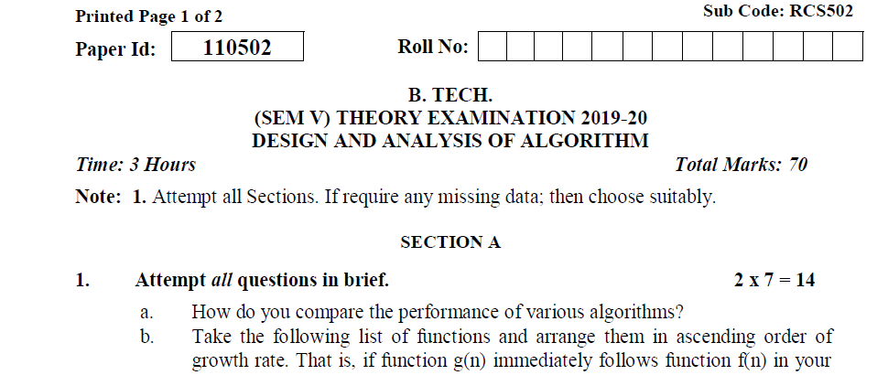
Old Question Papers(2019-2020)

Slide 97
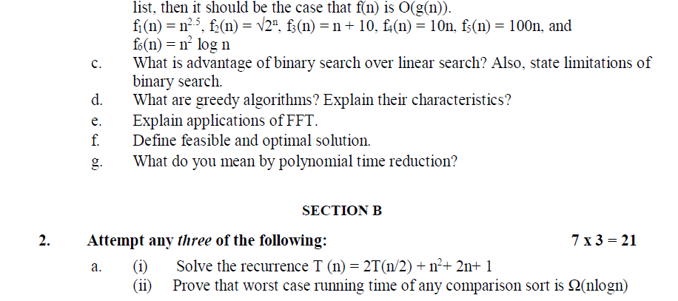
Old Question Papers(2019-2020)

Slide 98
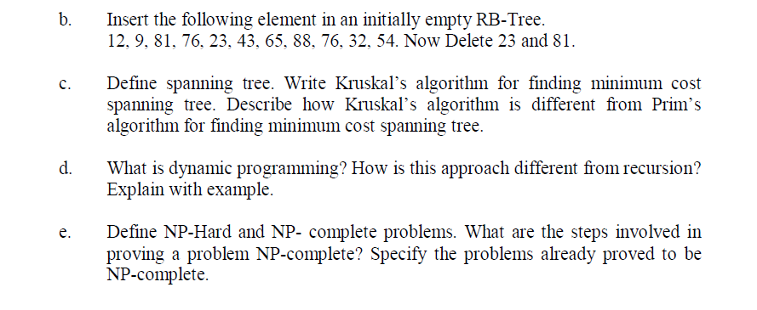
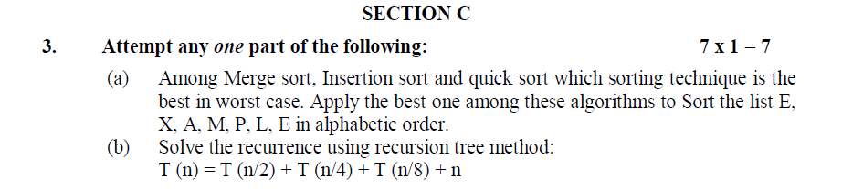
Old Question Papers(2019-2020)

Slide 99
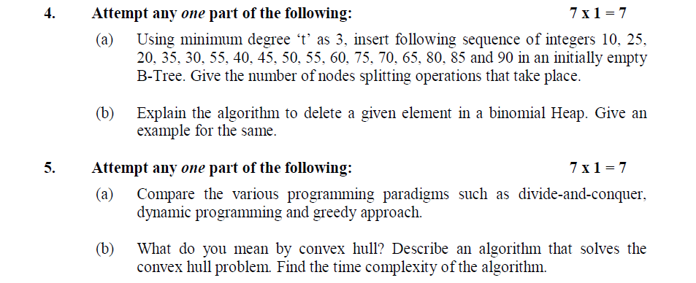
Old Question Papers(2019-2020)

Slide 100
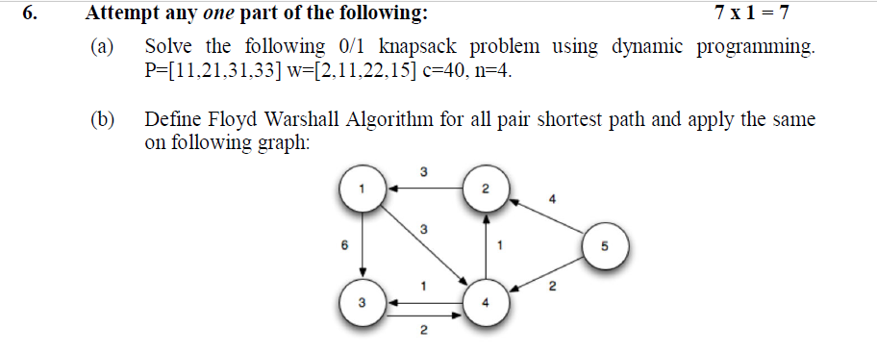
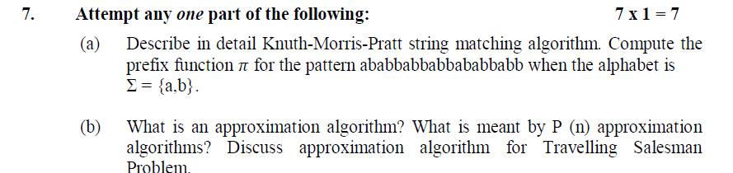
Old Question Papers(2019-2020)

Slide 101
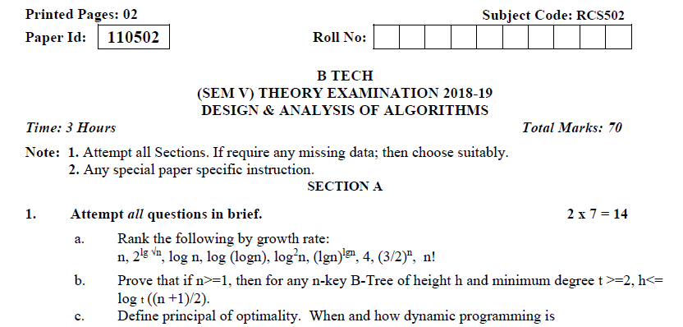
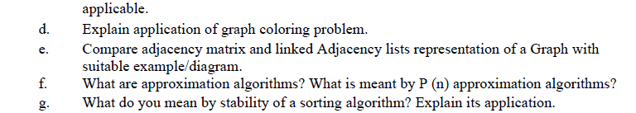
Old Question Papers(2018-2019)

Slide 102
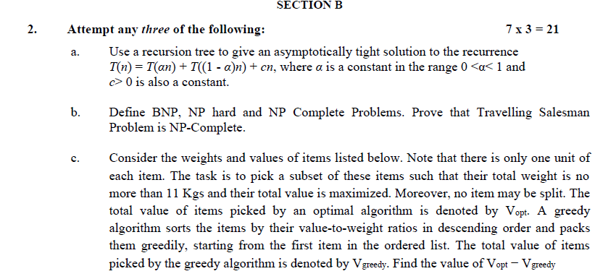
Old Question Papers(2018-2019)

Slide 103
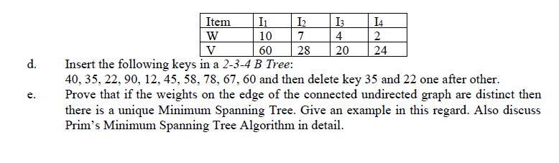
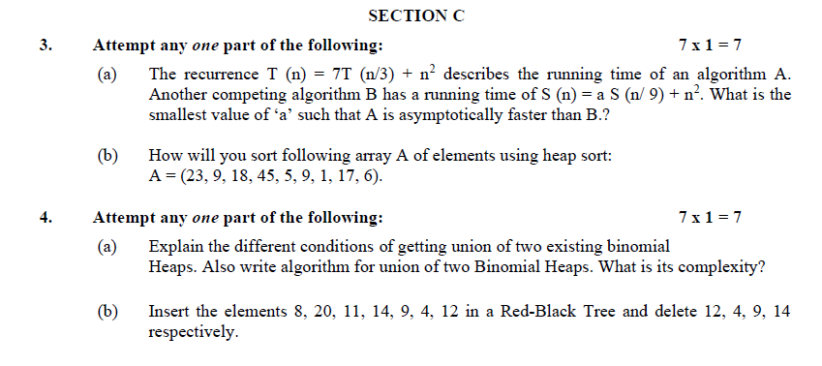
Old Question Papers(2018-2019)

Slide 104
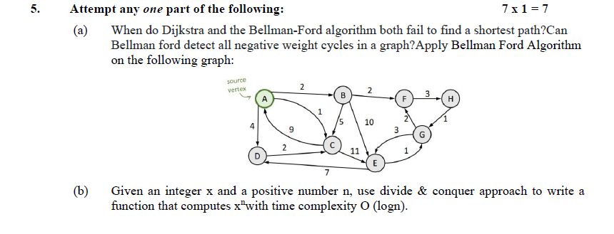
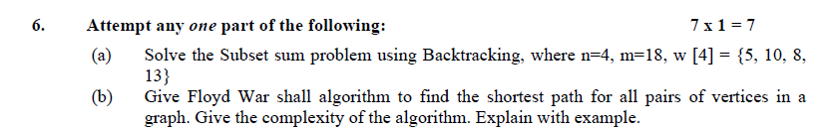
Old Question Papers(2018-2019)

Slide 105
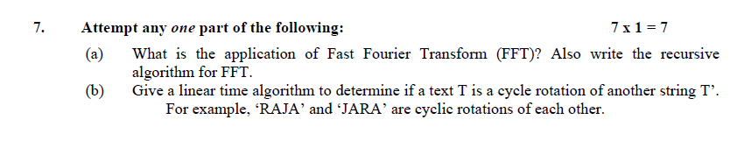
Old Question Papers(2018-2019)

Slide 106
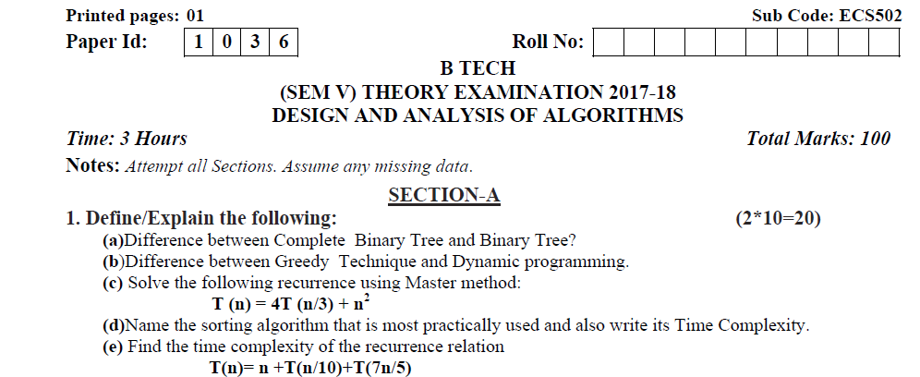
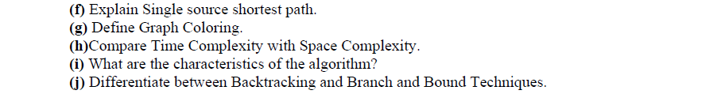
Old Question Papers(2017-2018)

Slide 107
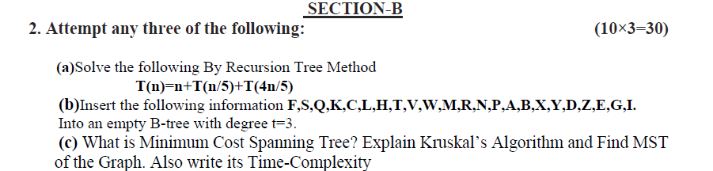
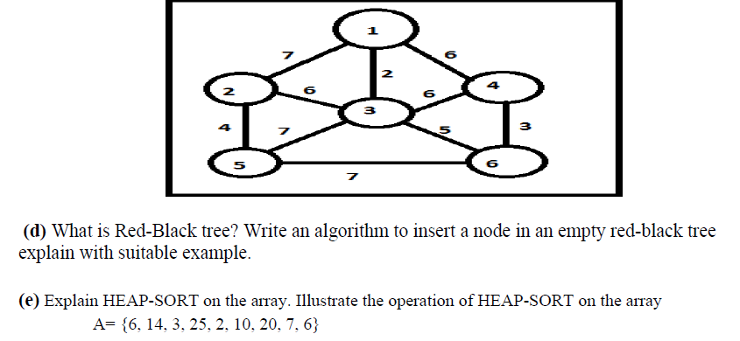
Old Question Papers(2017-2018)

Slide 108
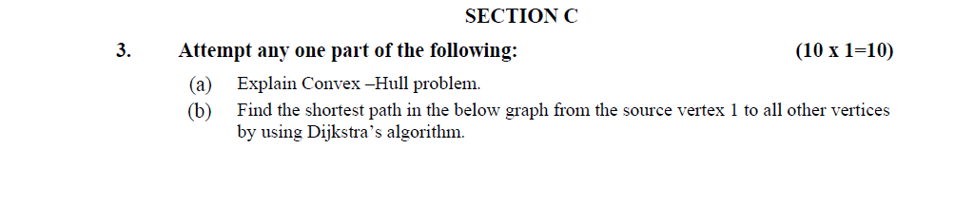
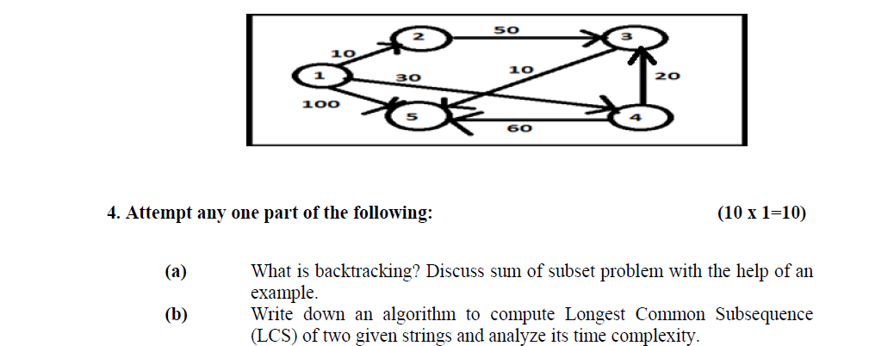
Old Question Papers(2017-2018)

Slide 109
Old Question Papers(2017-2018)

Slide 110
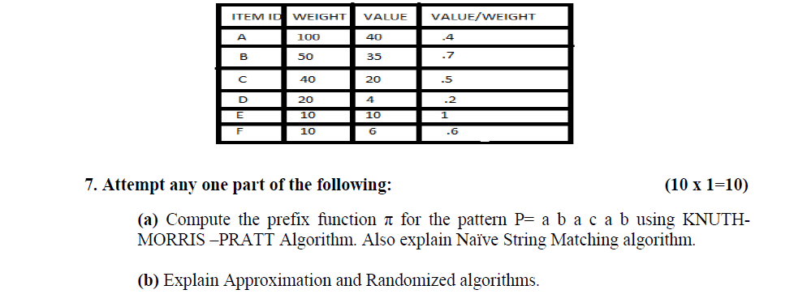
Old Question Papers(2017-2018)

Slide 111
Expected Questions for University Exam
What are the different applications of DFT and FFT? [CO5]
Discuss the string matching algorithms along with an example.e [CO5]
How is approximation algorithm different from randomized algorithm? [CO5]
Explain Naive string matching algorithm. [CO5]
Discuss the problem classes, NP, P, NPC along with their [CO5] relationship.

Slide 112
Recap Of Unit
This unit gives the insights of different classes of problems , P Class, NP class, NPC. The different string matching algorithms have been discussed. The Approximation algorithm and Randomized algorithm have also been explained.

Slide 113
Unit 5
Thank You

